Slide 1


University Data Management Case Study
By Ahmed Atef Mahmoud

Slide 2
Table of contents
01
02
03
04
05
06
Case Study Overview
Introduction
Database Design
SQL & PlSQL Implementation
Automation Using Bash
Java App Development
Q&A

Slide 3
01
Case Study Overview

Slide 4
Case Study Overview
The objective of this project is to design and implement a comprehensive data management system for a university using SQL, PLSQL, Bash scripting, Java SE, and OOP principles.
The project encompasses various aspects, including database design, SQL and PLSQL implementation, automation scripts, Java application development, and integration.

Slide 5
Requirements
Database Requirements
Student Management:
Store student information, including ID, name, email, gender, and date of birth.
Track the department to which each student belongs.
Course Management:
Manage course details, including ID, name, code, and the number of credit hours.
Establish prerequisites for each course.
Grade Management:
Record grades for students in different courses.
Include details such as student ID, course ID, and the grade obtained.
Department Management:
Keep track of departments, including ID, code, and name.

Slide 6
Requirements
Automation Requirements
Backup and Maintenance:
Bash scripts for automating backups, updates, and routine maintenance tasks.
Application Features
User Interface:
Java application providing a user-friendly interface for administrators.
Integration:
Seamless integration between the Java application and the relational database.
CRUD Functionality:
CRUD operations (Create, Read, Update, Delete) for students, courses, grades, and departments.

Slide 7
02
Database Design

Slide 8
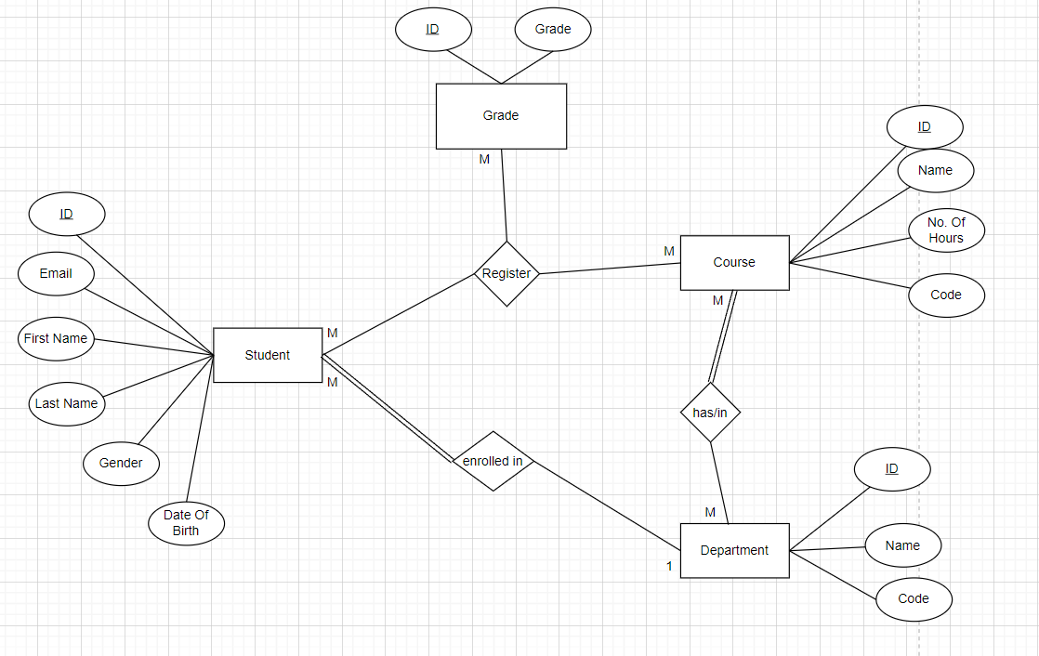
Entity Relationship Diagram

Slide 9
Database Design
Entities
Attributes
Student
Course
Grade
Department
Student: ID, Name, Email, Gender, DOB, Department
Course: ID, Name, Code, Credit Hours
Grade: Student ID, Course ID, Grade
Department: ID, Code, Name
Relationships
Many Students Will Be in One Department
Many Students Enrolls in Many Courses
Many Courses will be assigned to Many Departments

Slide 10
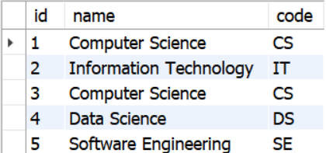
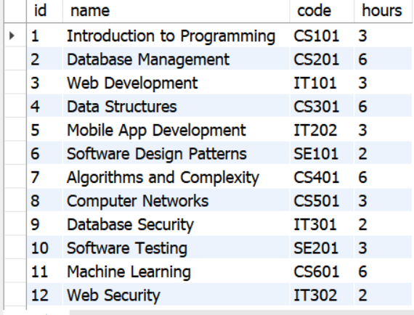
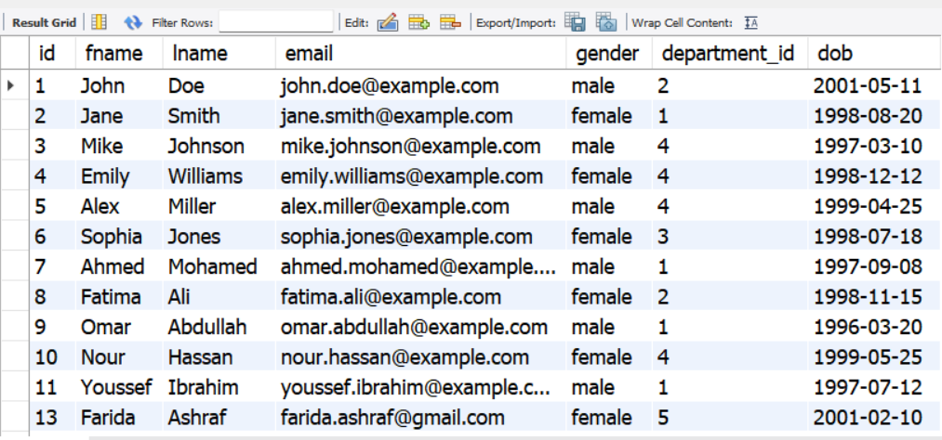
So, the data will be like this

Slide 11
03
SQL & PlSQL Implementation

Slide 12
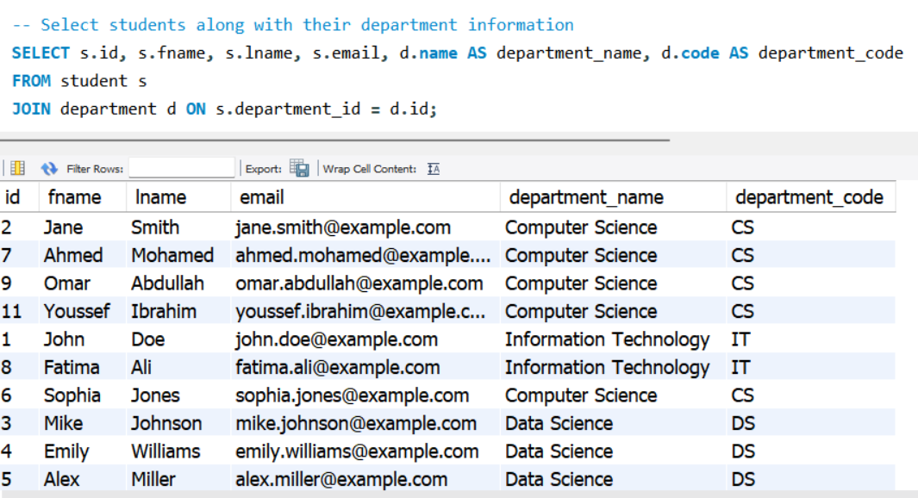
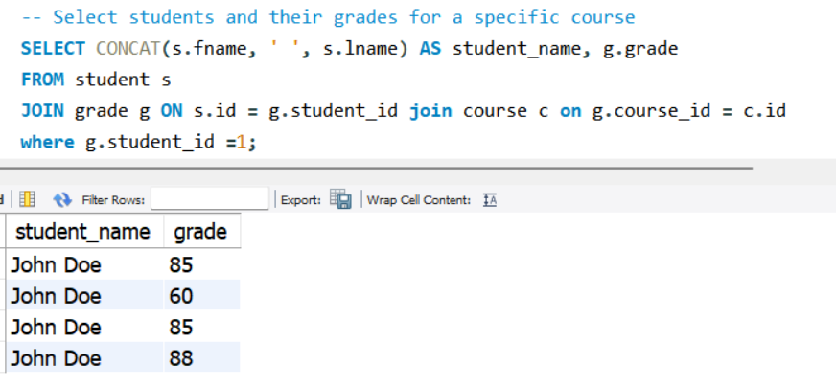
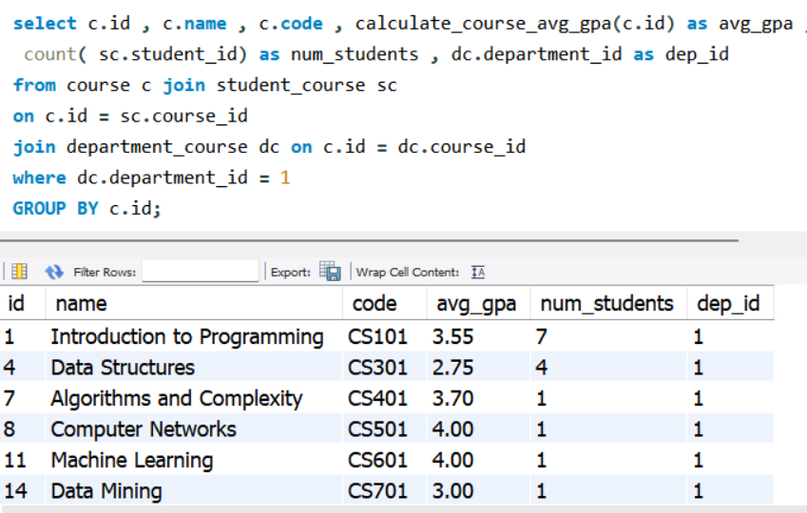
SQL & PlSQL Implementation
Using MYSQL Workbench , here is some screenshots to show the database from different aspects

Slide 13
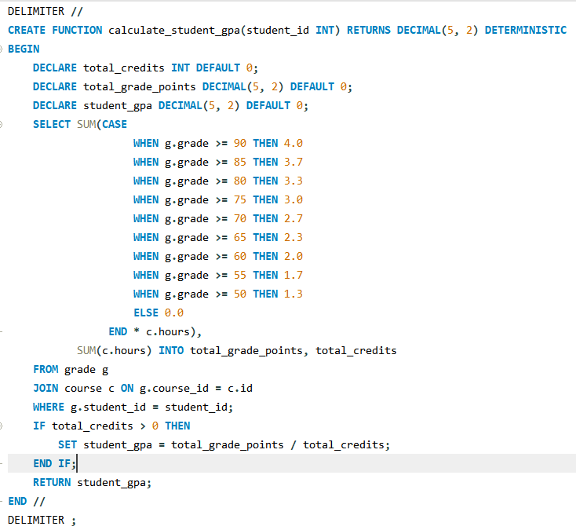
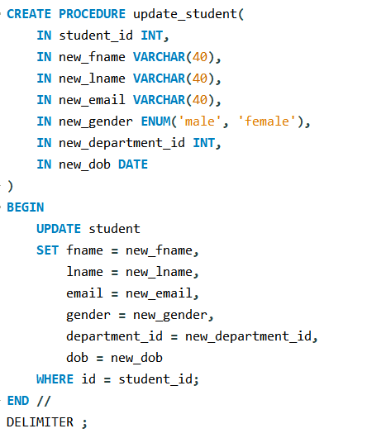
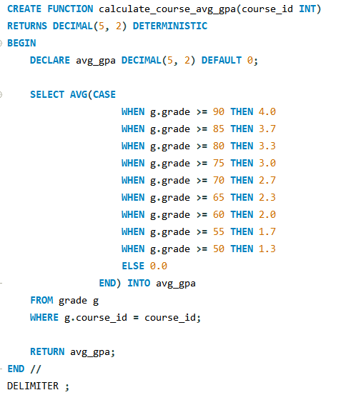
SQL & PlSQL Implementation Cont.

Slide 14
04
Automation Using Bash

Slide 15
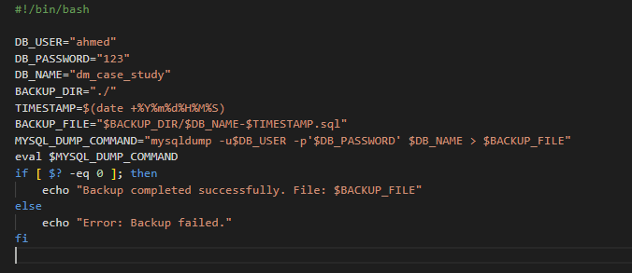
Automation Using Bash Cont.
MySQL Database Backup
Performs a backup of a MySQL database.

Slide 16
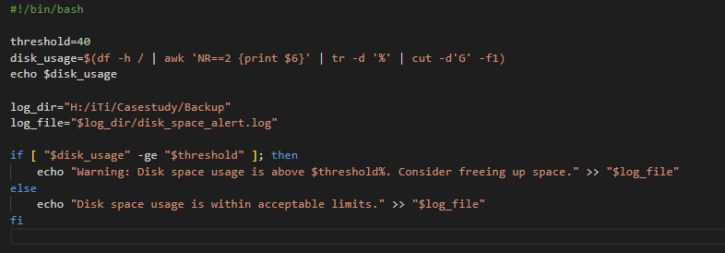
Automation Using Bash
Disk Space Monitoring
Monitors disk space usage and sends an alert if it exceeds a specified threshold.

Slide 17
05
Java App Development

Slide 18
Java App Development
Overview
The Student Management System allows users to perform operations such as adding, updating, and selecting information related to students, courses, grades, and departments. It also supports the assignment of courses to students.
Features
Student Management: Add, update, and view student information.
Course Management: Add, update, and view course information.
Grade Management: Add, update, and view student grades for courses.
Department Management: Add, update, and view department information.
Course Assignment: Assign courses to students.
Graphical User Interface: Intuitive UI for easy navigation.
Charts: Visual representation of student age, average grades per course, and average grades per department.

Slide 19
Java App Development Cont.
Code Structure
The code is structured into various methods and functions, each responsible for specific tasks. The main sections include:
StudentScene: Manages student-related functionalities.
CourseScene: Manages course-related functionalities.
GradeScene: Manages grade-related functionalities.
DepartmentScene: Manages department-related functionalities.
MainController: Controls the main functionality and GUI switching.
DatabaseAccessLayer: Provides database connectivity and SQL operations.

Slide 20
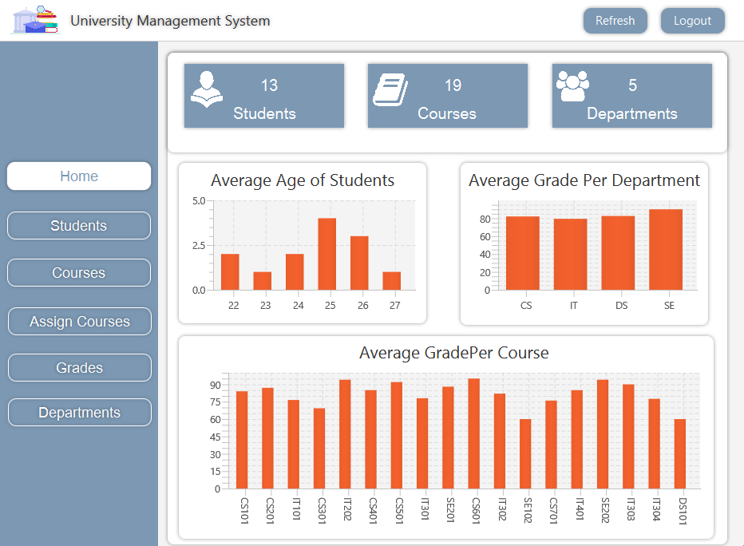
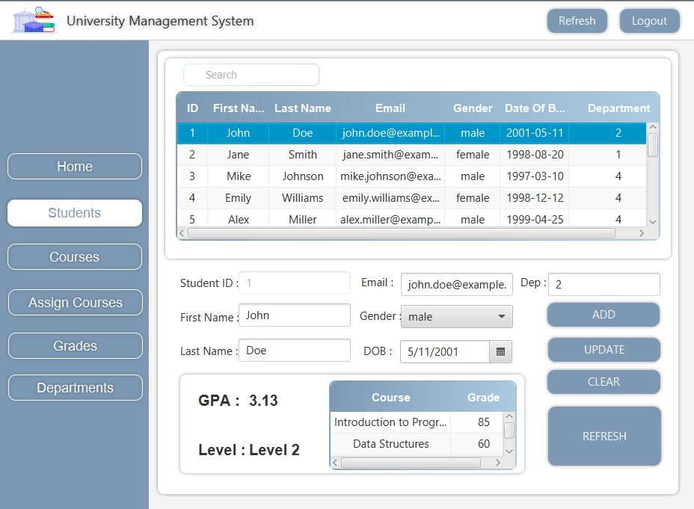
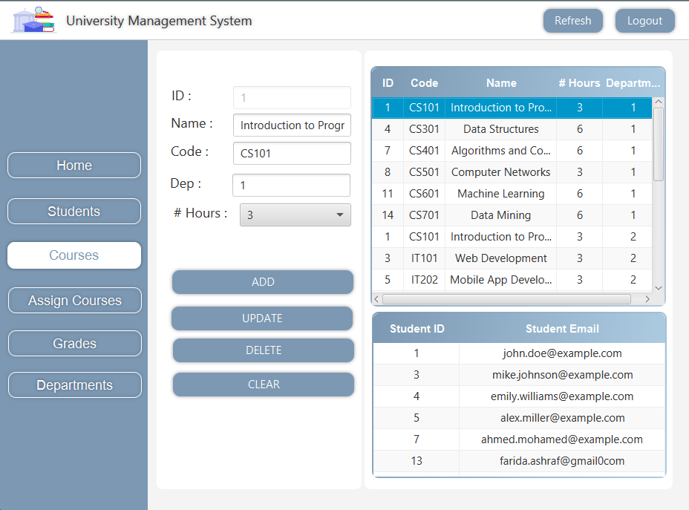
Java App Development Cont.

Slide 21
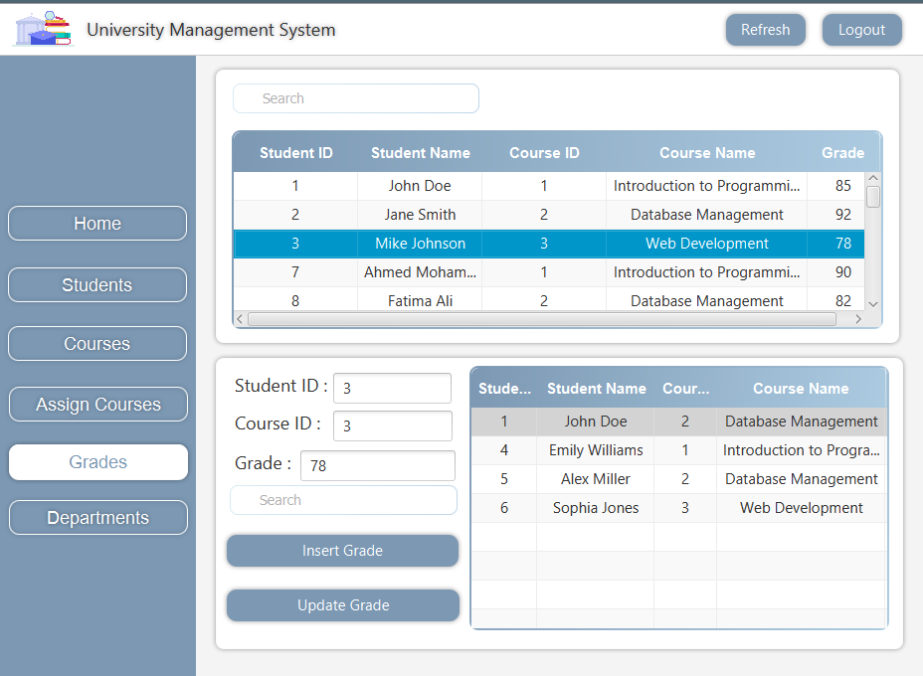
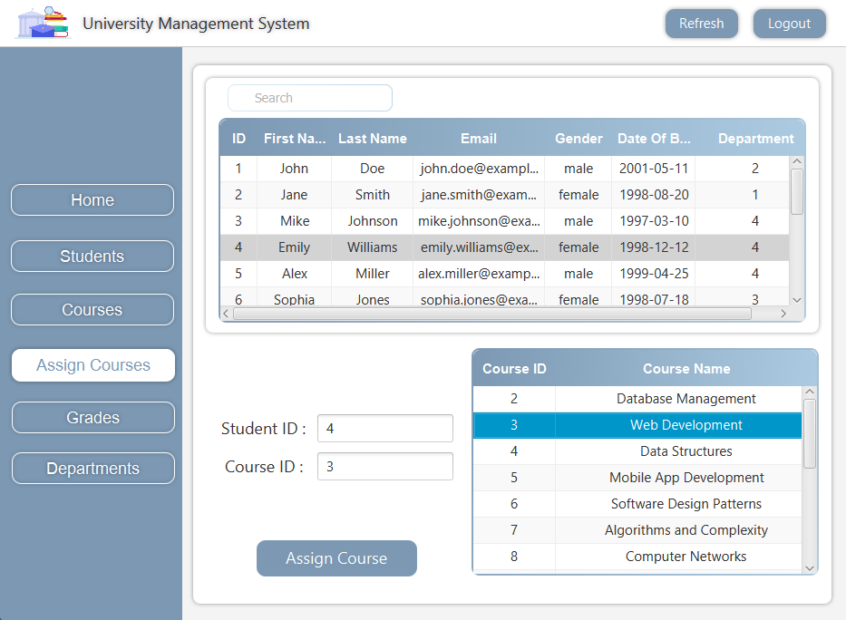
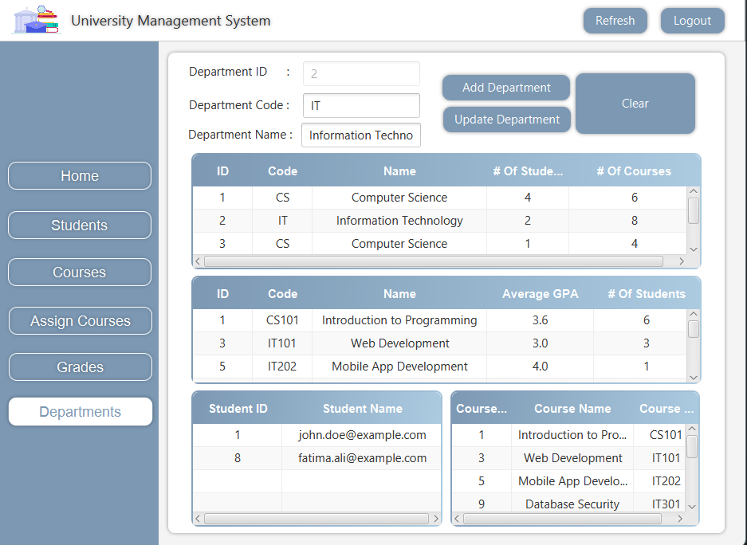
Java App Development Cont.

Slide 22
06
Q&A

Slide 23
Thanks!

